Slide 1

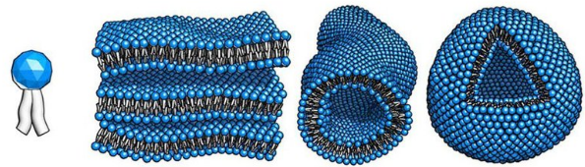
Self- assembly
Supramolecular chemistry
Εργασία για το μάθημα «Υπερμοριακή Χημεία»
Υπεύθυνος καθηγητής: Κουτσολέλος Αθανάσιος
Τσούτσα Μαρία Ελένη
23-05-2019

Slide 2

What is self-assembly

Slide 3
Self- assembly
Self-assembly is a process in which building blocks autonomously organize to form stable supermolecules of higher order and complexity through domination of weak, noncovalent interactions, like:
Hydrogen-bonding,
Hydrophobic interactions,
π-π stacking,
Van der Waals forces,
Metal-ligand complexation,
Electrostatic interaction
* Kinetically labile covalent bonds

Slide 4
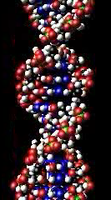
Self- assembly
‘Supramolecule' was introduced by Karl Lothar Wolf and his co-workers in 1937
Development and understanding of the self-assembled structures formed by amphiphilic molecules
Amphiphiles with a polar head group and non-polar tail are the basic building blocks of supramolecular self-assemblies

Slide 5
Self- assembly
Structural diversity of the amphiphilic molecules and modes of interactions among themselves in varying medium result in the formation of self-assembled structures like:
micelles,
reverse micelles,
microemulsions,
liquid crystals,
vesicles,
fibres,
gels and
many others

Slide 6
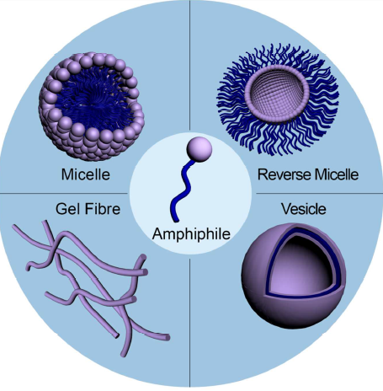
Different expression of supramolecular self assemblies
Sarkar et al., “Tailor-Made Self-Assemblies from Functionalized Amphiphiles: Diversity and Applications”, ACS Pub, 2018

Slide 7
Some interesting applications

Slide 8
Synthesis of Polyaniline Nanotubes Using Self-Assembly : Application in gas sensing
Environmental problems (Toxic gases)
Semiconductor gas sensors :
high sensitivity
fast response time
simple fabrication, and
Low cost
Vast used are the metal-oxide semiconductor (MOS), such as
SnO₂, το ZnO₂ και το Fe₂O₃
Problem!!
Only work at high temperature
The solution…
Conducting polymers (CPs) and especially polyaniline (PANI)
Yin et al., “Facile Synthesis of Polyaniline Nanotubes Using Self-Assembly Method Based on the Hydrogen Bonding: Mechanism and Application in Gas Sensing”, Polymers, 2017

Slide 9
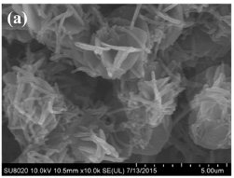
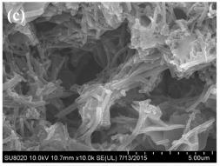
Synthesis of Polyaniline Nanotubes Using Self-Assembly : Application in gas sensing
SEM images of PANI with CA/ANI: (a) 0,01 (c) 0,1
Yin et al., “Facile Synthesis of Polyaniline Nanotubes Using Self-Assembly Method Based on the Hydrogen Bonding: Mechanism and Application in Gas Sensing”, Polymers, 2017

Slide 10
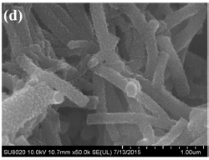
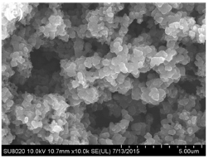
Synthesis of Polyaniline Nanotubes Using Self-Assembly: Application in gas sensing
SEM images of PANI with CA/ANI: (d) 0,5 (e) 2
Yin et al., “Facile Synthesis of Polyaniline Nanotubes Using Self-Assembly Method Based on the Hydrogen Bonding: Mechanism and Application in Gas Sensing”, Polymers, 2017

Slide 11
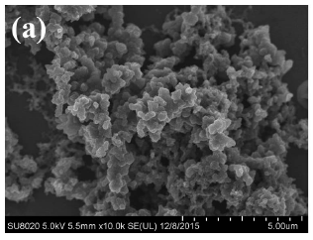
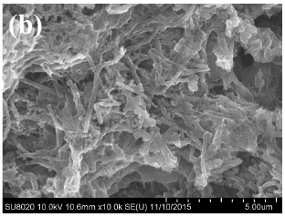
Synthesis of Polyaniline Nanotubes Using Self-Assembly: Application in gas sensing
SEM images of the samples prepared at CA/Ani = 0.5 (a) at room temperature for 24 h (b) at ice bath with mechanical stirring for 24 h.
Yin et al., “Facile Synthesis of Polyaniline Nanotubes Using Self-Assembly Method Based on the Hydrogen Bonding: Mechanism and Application in Gas Sensing”, Polymers, 2017

Slide 12
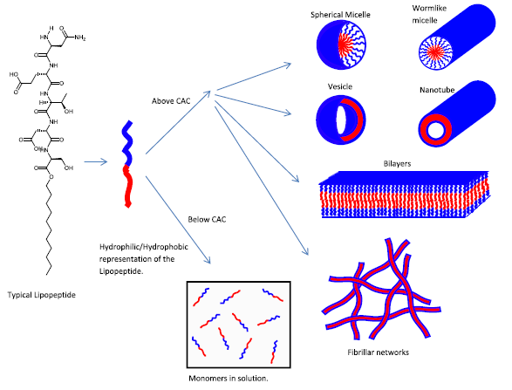
Molecular interactions and self-assembled structures of typical lipopeptides
J. A. Hutchinson et al., “Peptide hormones and lipopeptides: from self-assembly to therapeutic applications”,
J. Pept. Sci., 2017

Slide 13
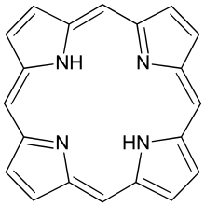
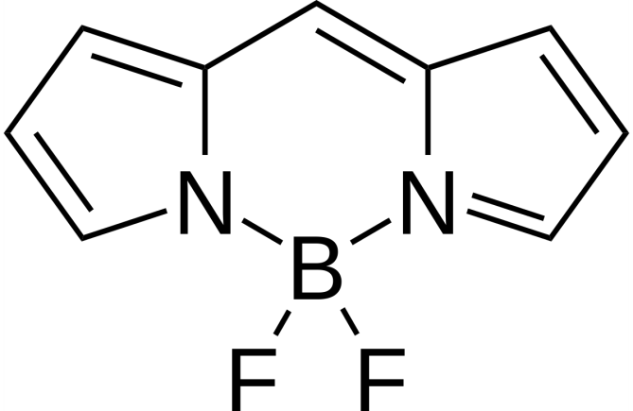
How we study self-assembly processes
Porphyrin Boron-dipyrrin (bodipy)

Slide 14
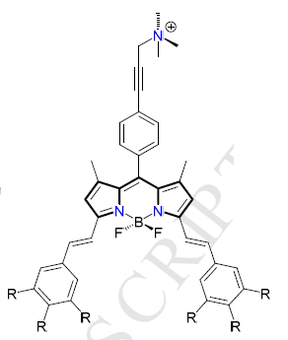
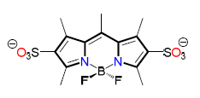
Self-assembly of charged fluorophores

Slide 15
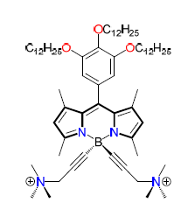
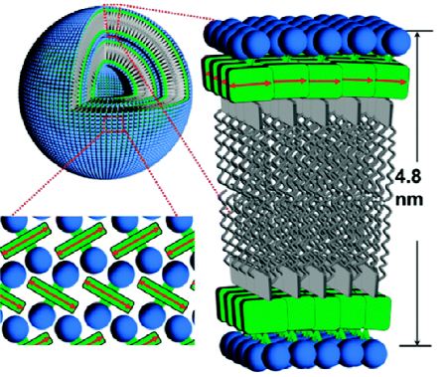
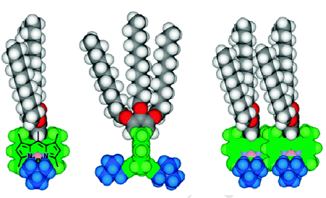
Self-assembly of charged fluorophores

Slide 16
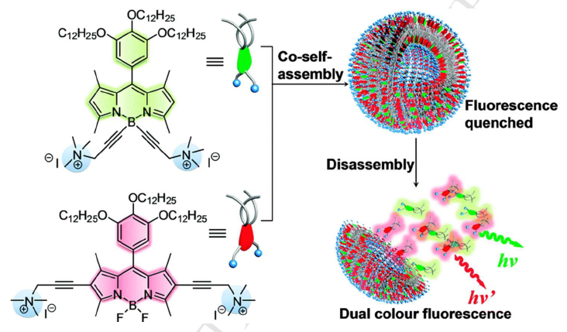
Self-assembly of charged fluorophores

Slide 17
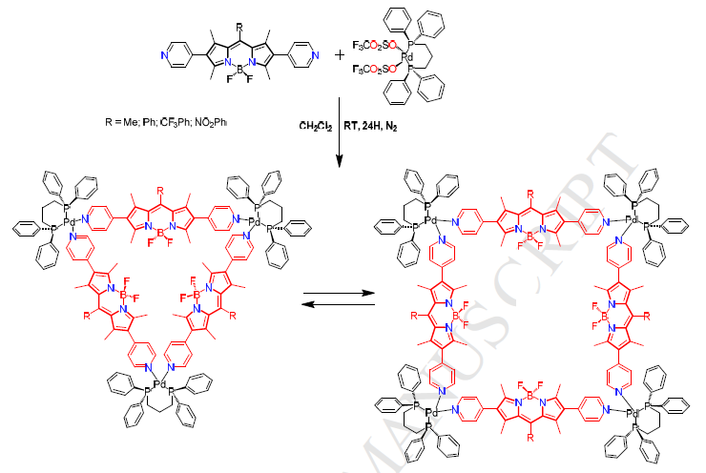
The synthesis scheme of bodipy-based coordination polymers (MOFs)

Slide 18
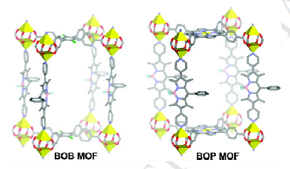
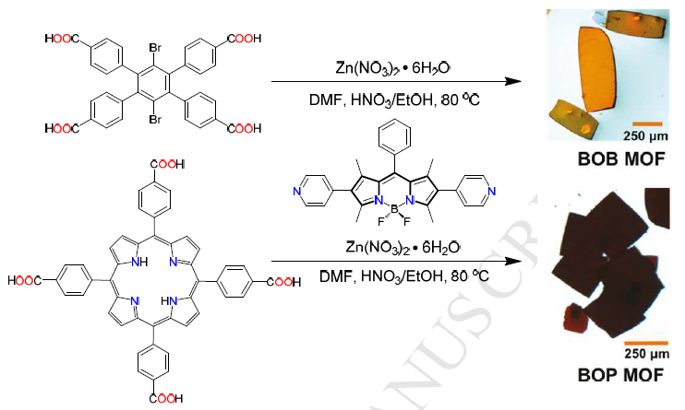
The synthesis scheme of bodipy-based coordination polymers (MOFs)

Slide 19
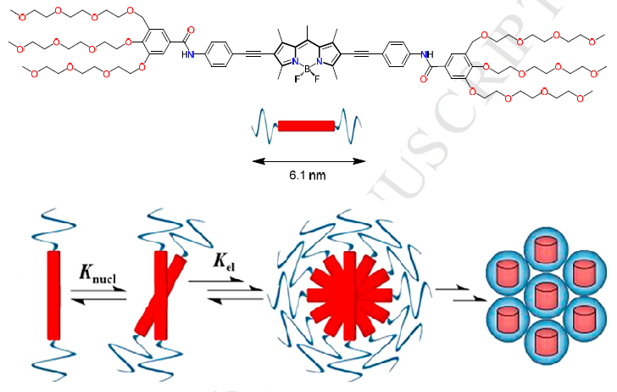
Nanostructured self-assembles based on preorganized fluorophores

Slide 20
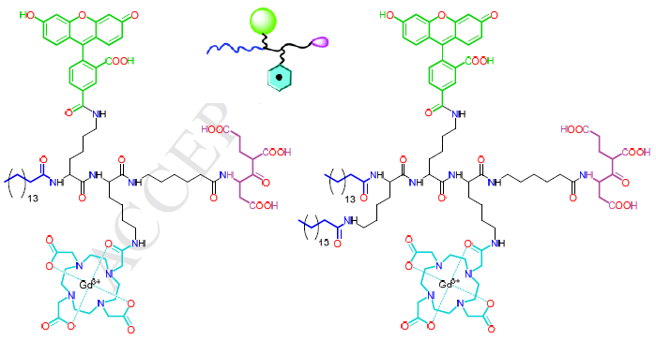
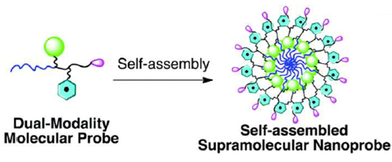
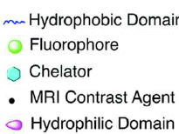
Self-organizing molecular probes

Slide 21

Ευχαριστώ για την προσοχή σας!

Slide 22
Βιβλιογραφία
Sarkar et al., “Tailor-Made Self-Assemblies from Functionalized Amphiphiles: Diversity and Applications”, ACS Pub, 2018
J. A. Hutchinson et al., “Peptide hormones and lipopeptides: from self-assembly to therapeutic applications”,J. Pept. Sci., 2017
Yin et al., “Facile Synthesis of Polyaniline Nanotubes Using Self-Assembly Method Based on the Hydrogen Bonding: Mechanism and Application in Gas Sensing”, Polymers, 2017
Solomonov et al., “Design and Applications of Dipyrrin-based Fluorescent Dyes and Related Organic Luminophores: From Individual Compounds to Supramolecular Self-Assembled Systems”, j.dyes and pigments, 2018

